Slide 1


Slide 2
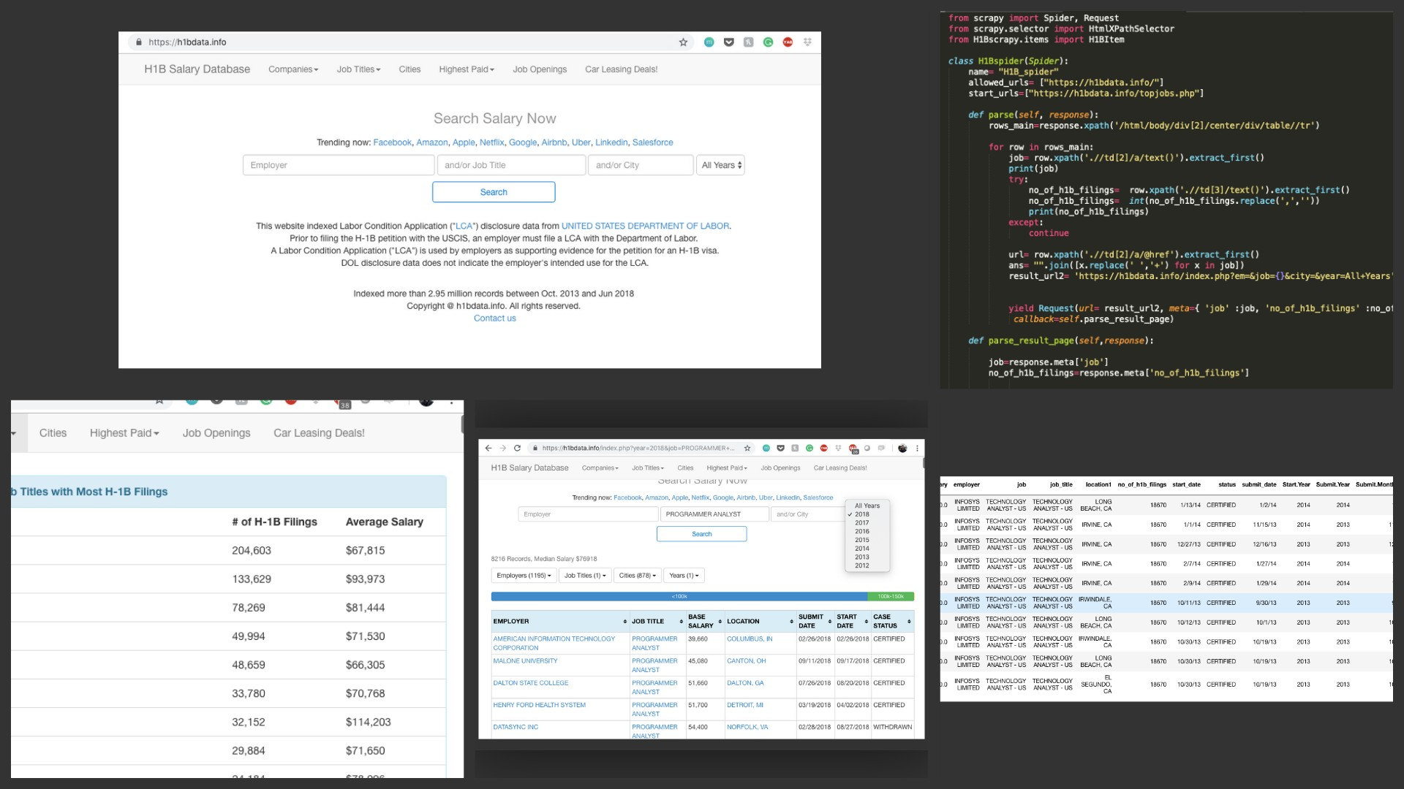

Slide 3

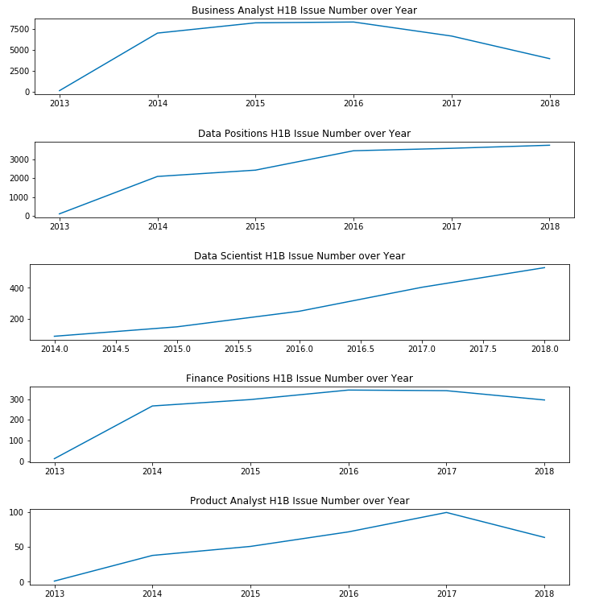
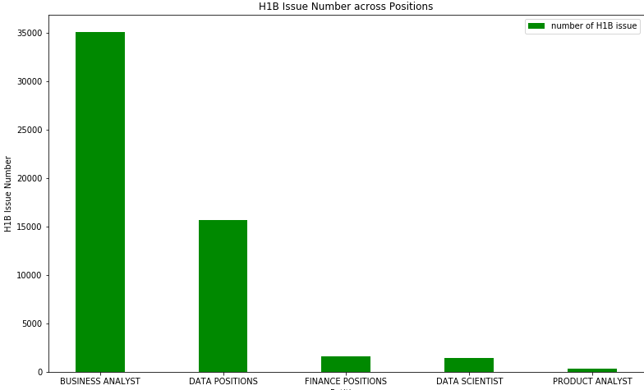
Descriptive Analysis
Over 1.5M obs including >78k employers and >18k job titles.
Data from 2009-2018
Presenting only from 2013 (scraping inefficiency)
Business analyst had most issues, product analyst had least.
Job market for data scientist has been booming whereas business analyst and product analyst has been declining

Slide 4
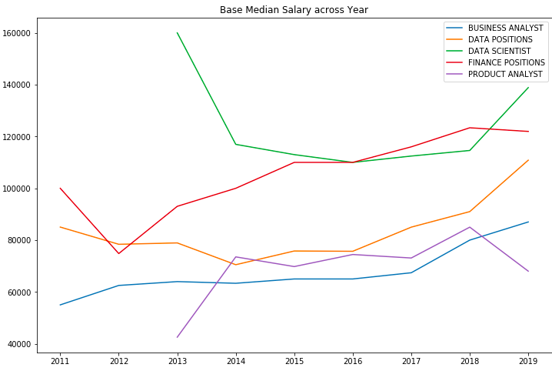
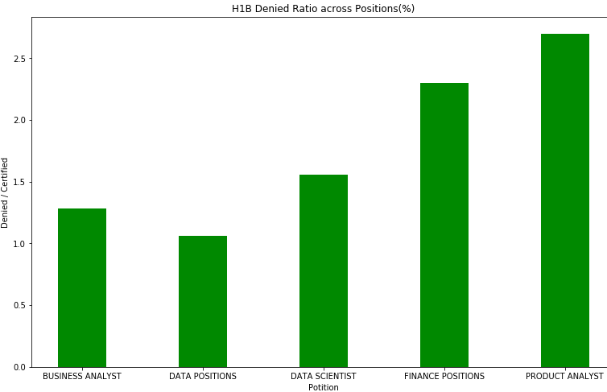
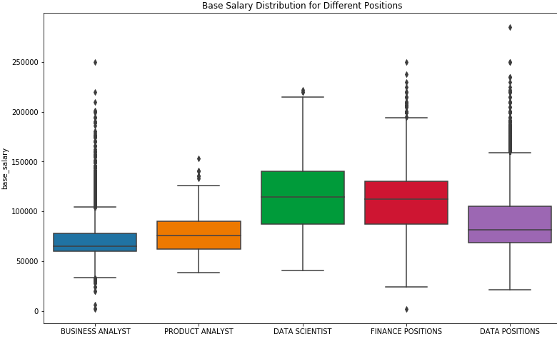
Interestingly, the base salary for business analyst has been increasing, whereas data scientist base salary is seen to be decreasing up untill 2018.
Median base salary- DS>Finance>PA>BA
Highest denied % is product analyst, followed by positions held in finance. (Not STEM?)

Slide 5
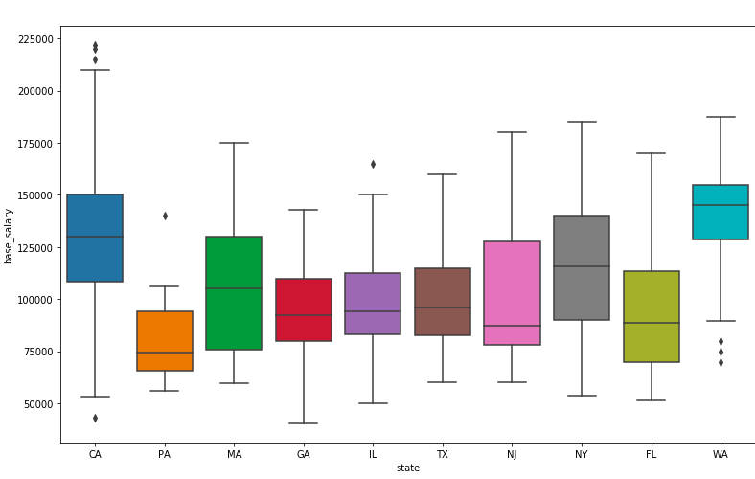
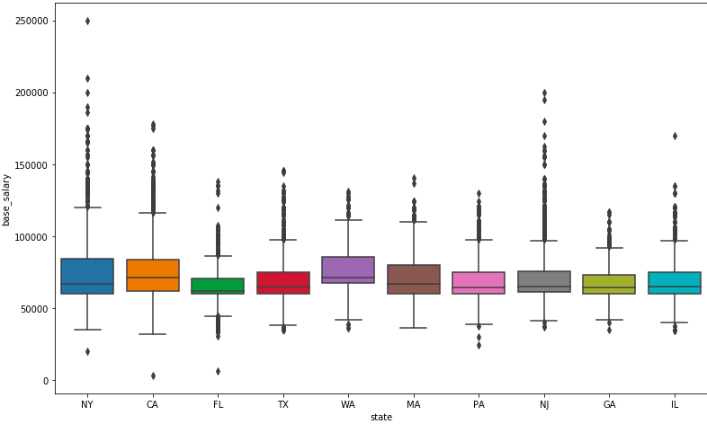
Data Scientist base salary dist. Over states with top 10 issuer
Business Analyst base salary dist. Over states with top 10 issuer
For Data Scientist, it was seen that the top issuers were CA, NY and WA.(AMZN, Microsoft?)
As for base salary, CA, MA, NY and WA have median of over 100k.
Correlate with cost of living in these cities (?)
For Business Analyst positions, leading issuers were NY and CA. but we can see the variations for salary aren’t that much.
A lot more outliers here, but doesn’t vary too much across states.

Slide 6
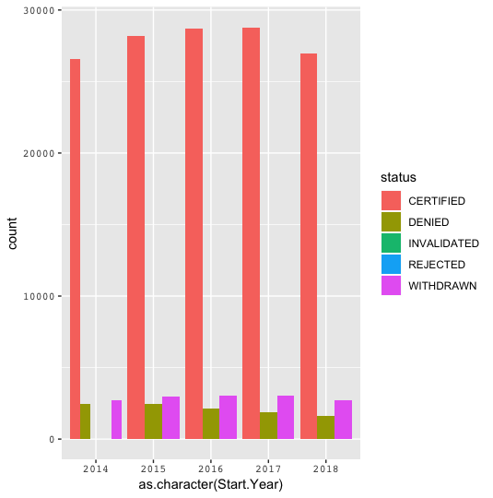
No of certified H1B has decreased in the year 2018. Total no. of issued has declined.
Uncertain political environment.
FURTURE WORK
Sentiment analysis on News/twitter data on H1B news
Quantify significance of this sentiment amongst companies filing for H1B

